Slide 1
Flow Aplikasi

Slide 2

Halo!
Rizal Darmawan

Slide 3
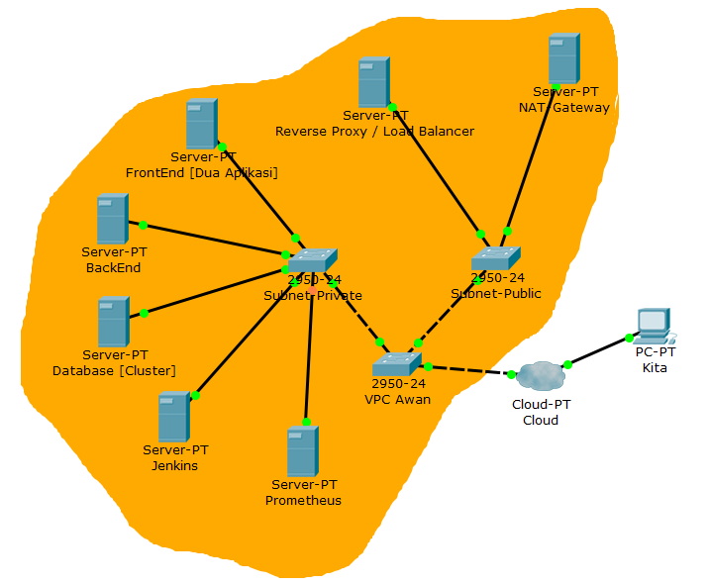
Design Infrastruktur

Slide 4





Tools

Slide 5
Langkah-langkah
Repository
User
Database
Deployment
Monitoring
Server
SSH
Web Server
CICD
AUTH
5

Slide 6
Repository
1
Clone Repository

Slide 7
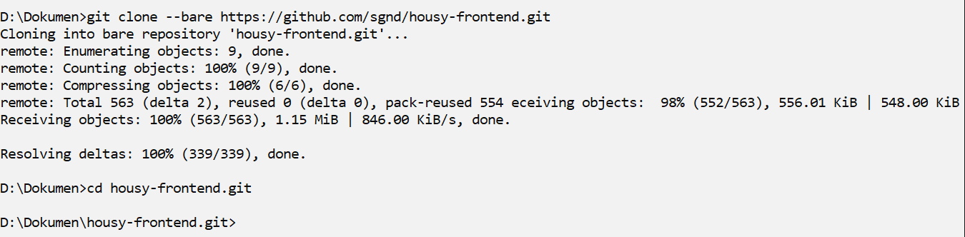
Repository
7

Slide 8
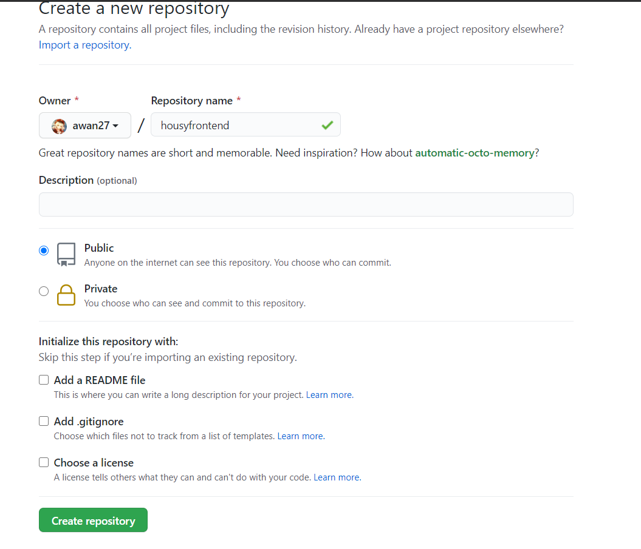
Repository
8

Slide 9
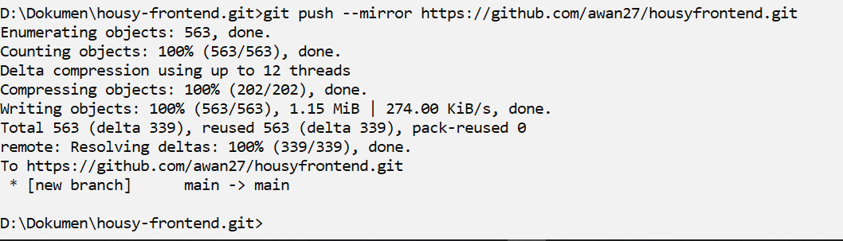
Repository
9

Slide 10
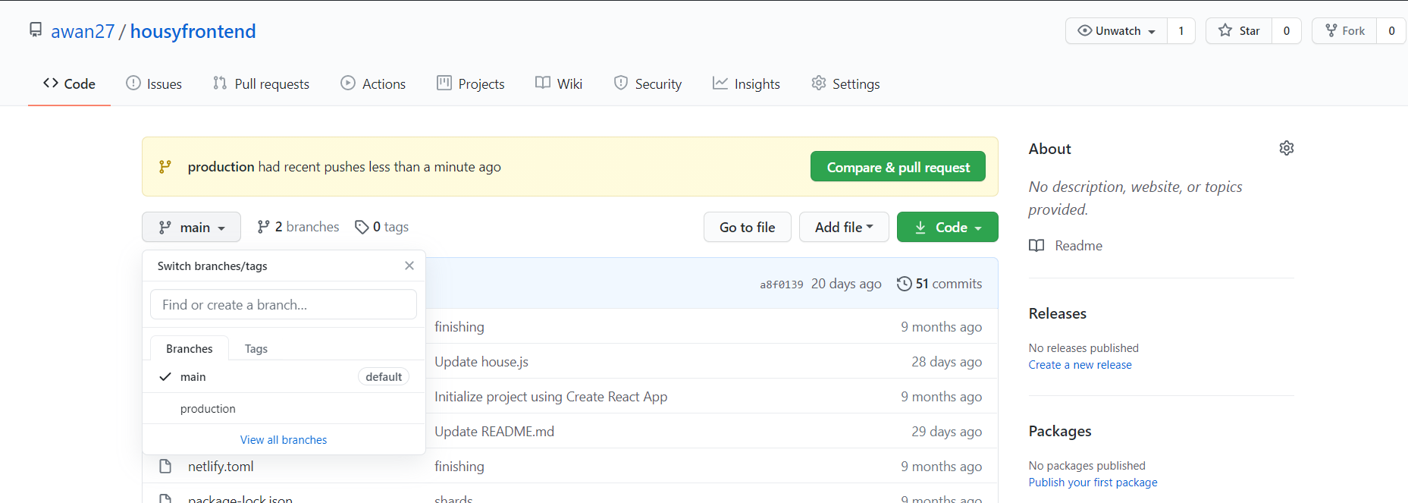
Repository
10

Slide 11
Server
2
Setting Server di AWS

Slide 12
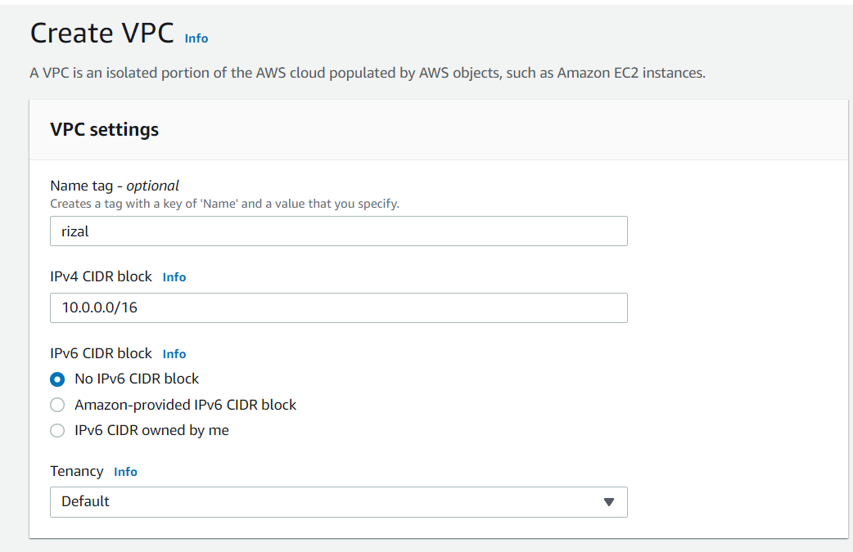
Server
12

Slide 13
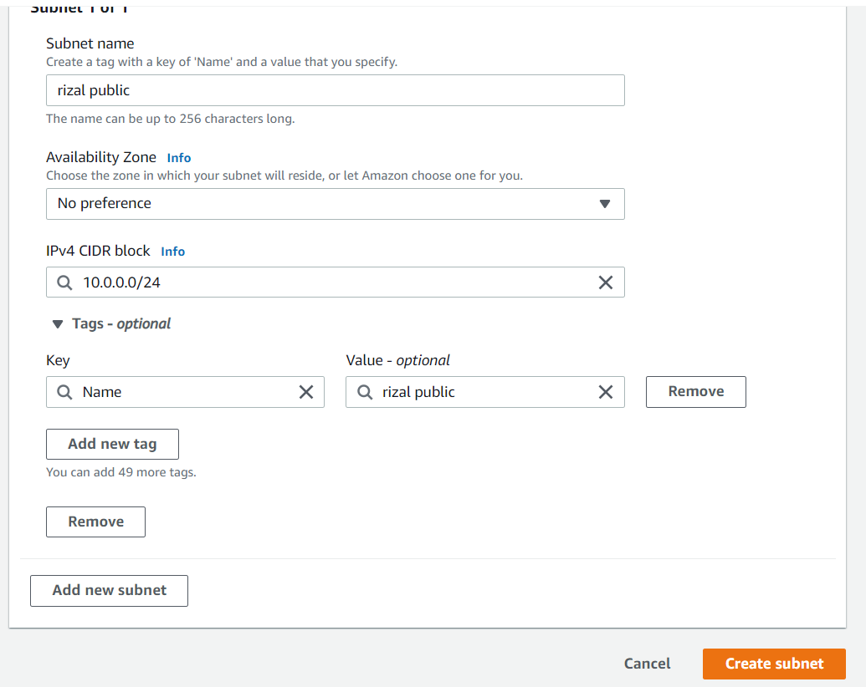
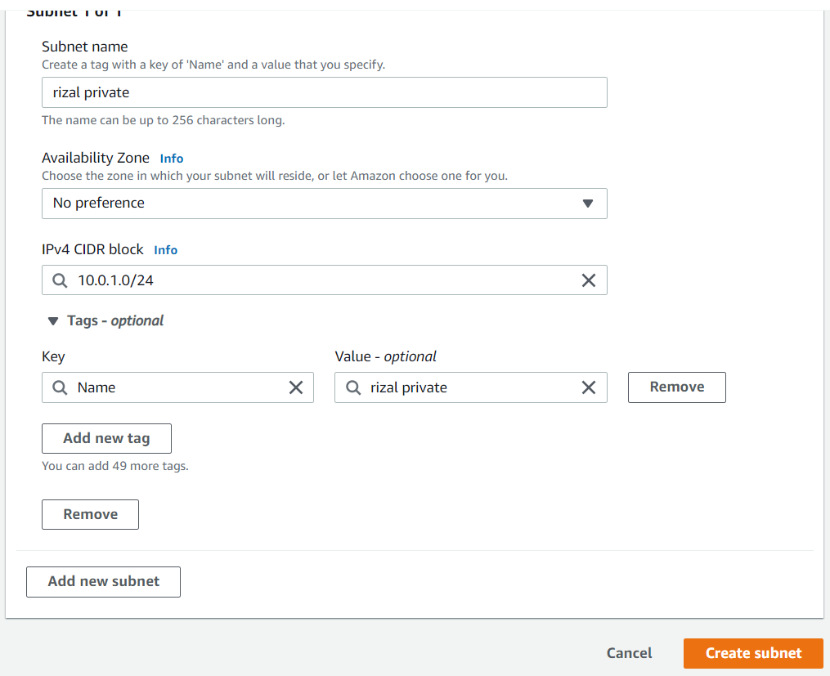
Server
13

Slide 14
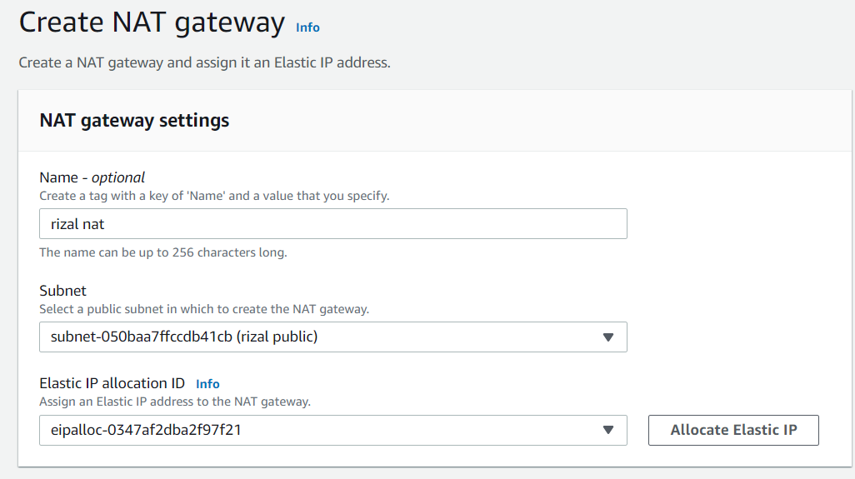
Server
14

Slide 15
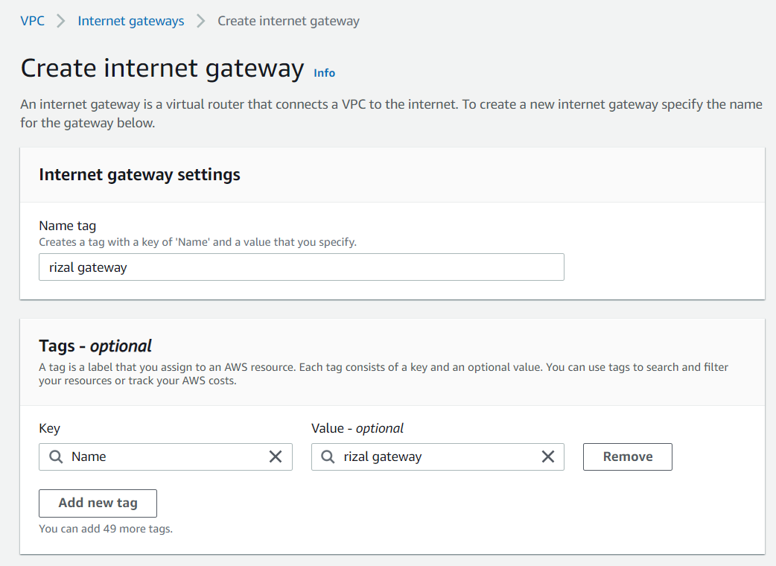
Server
15

Slide 16
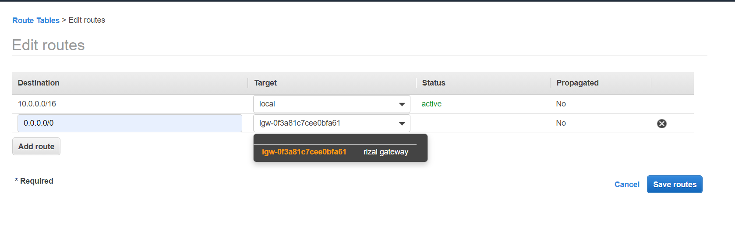
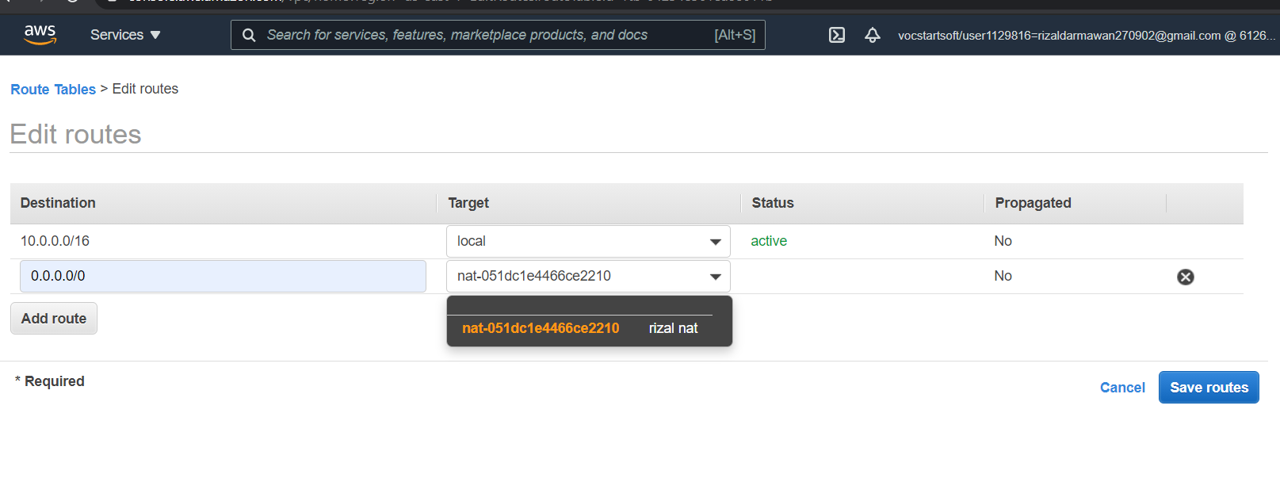
Server
16

Slide 17
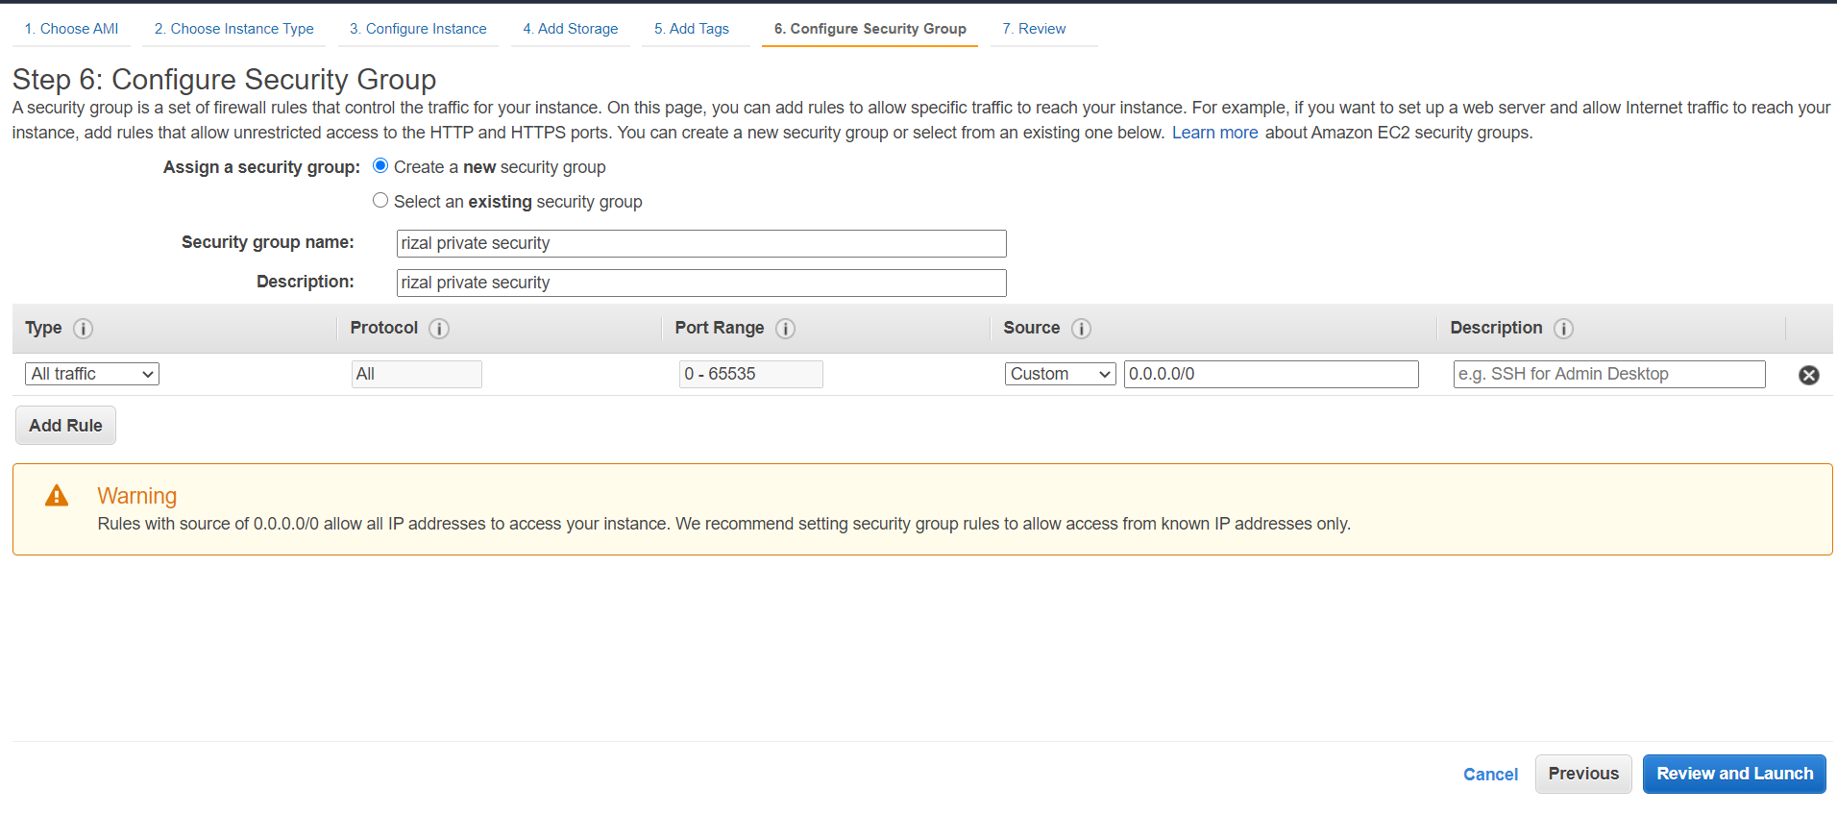
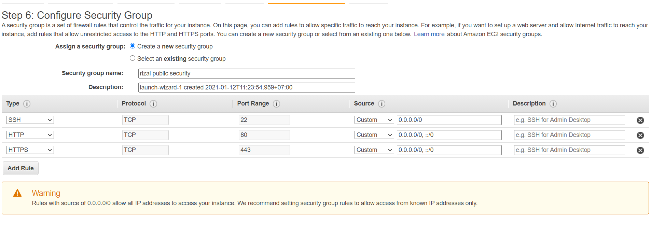
Server
17

Slide 18
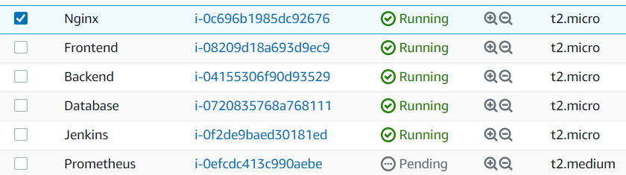
Server
18

Slide 19
User
3
Buat user dengan ansible

Slide 20
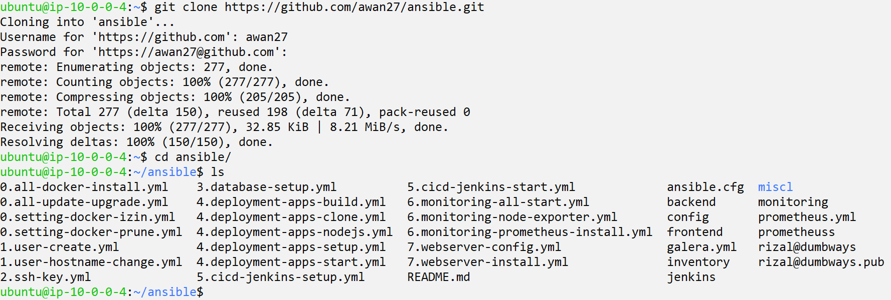
User
20

Slide 21
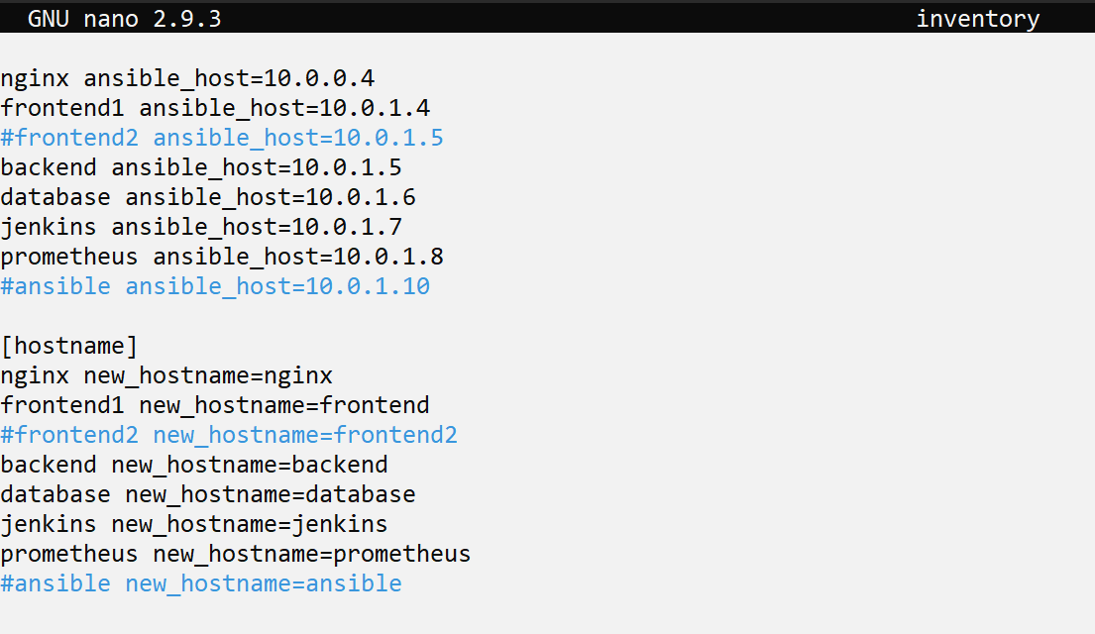
User
21

Slide 22
User
22

Slide 23
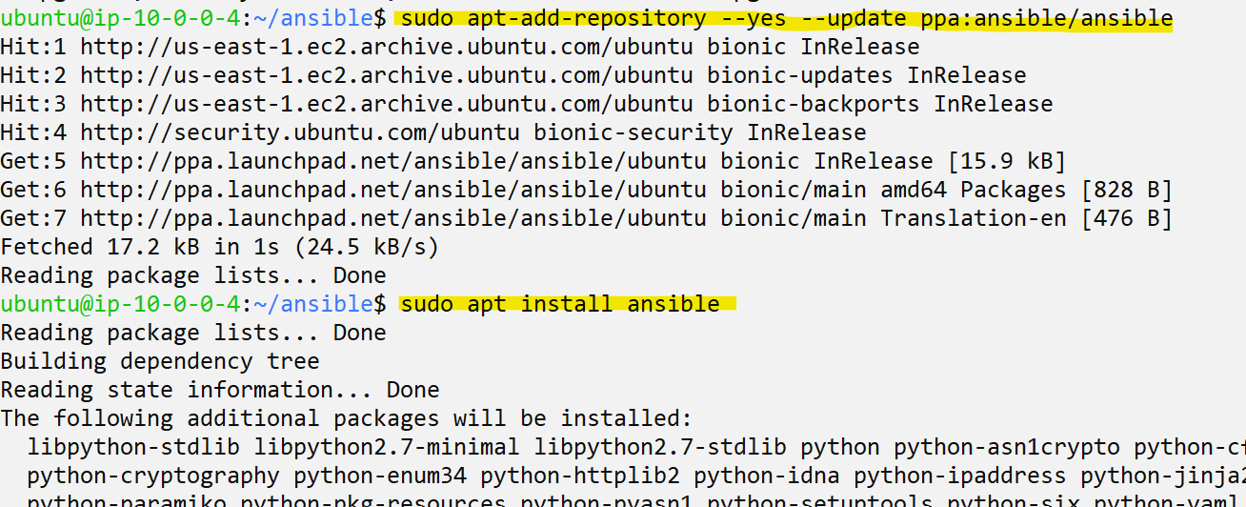
User
23

Slide 24
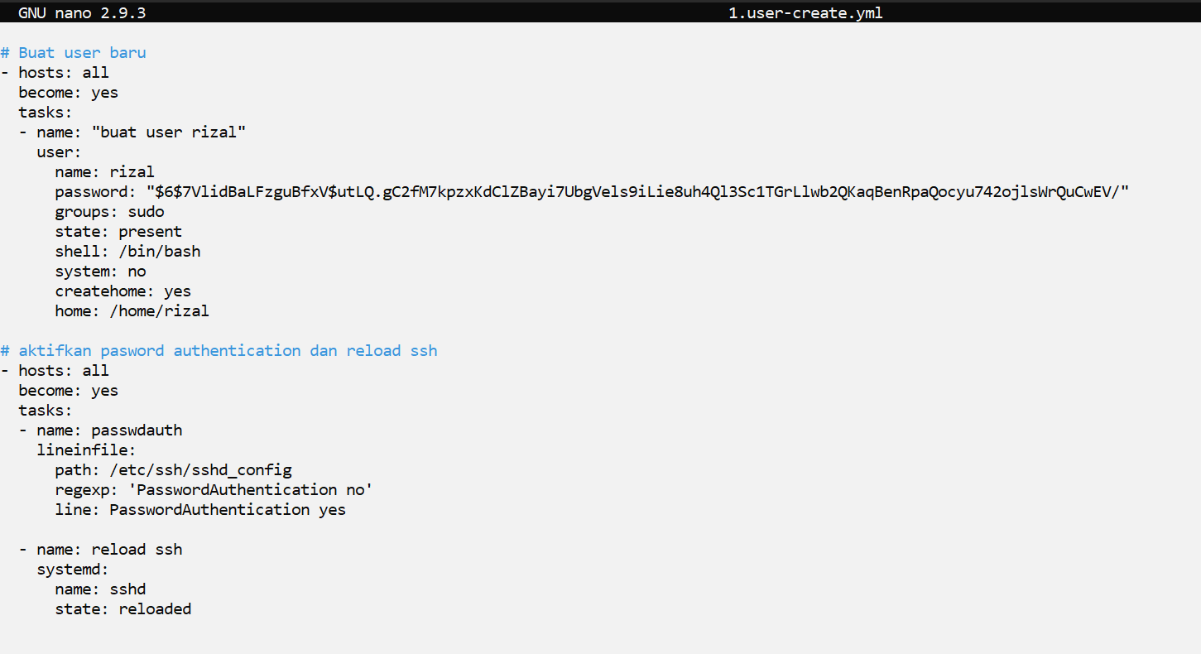
User
24

Slide 25
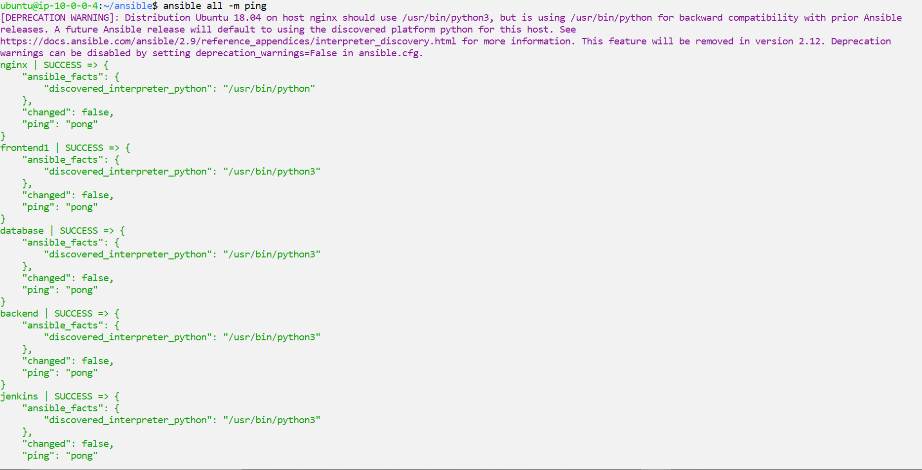
User
25

Slide 26
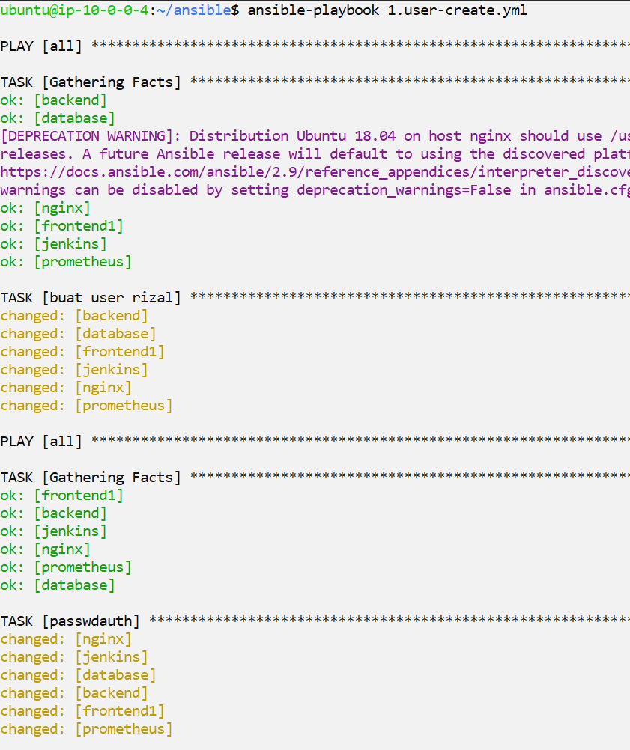
User
26

Slide 27
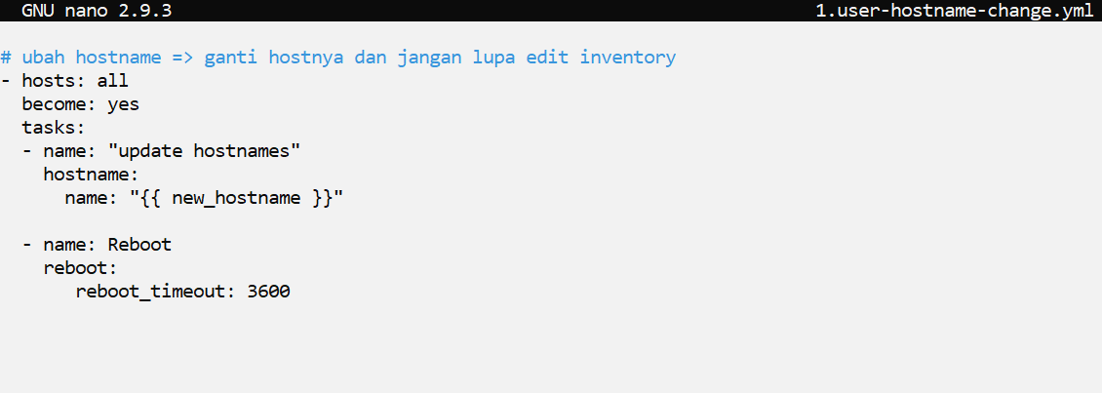
User
27

Slide 28
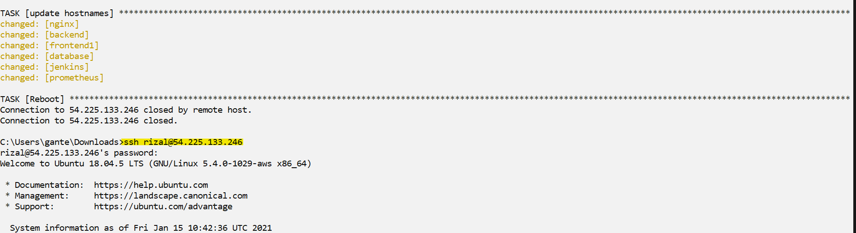
User
28

Slide 29
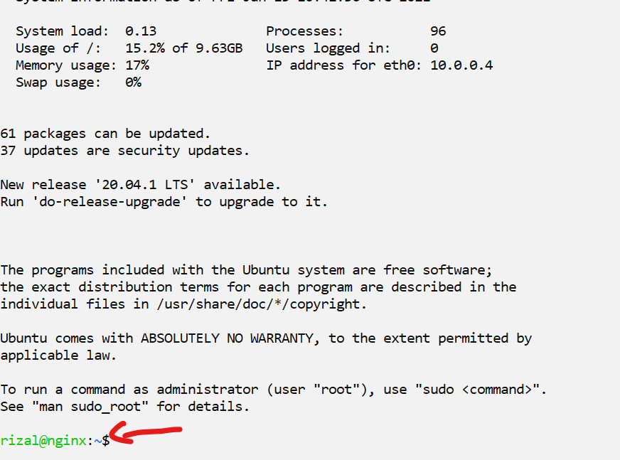
User
29

Slide 30
SSH
4
Bisa remote setiap server dan github passwordless

Slide 31
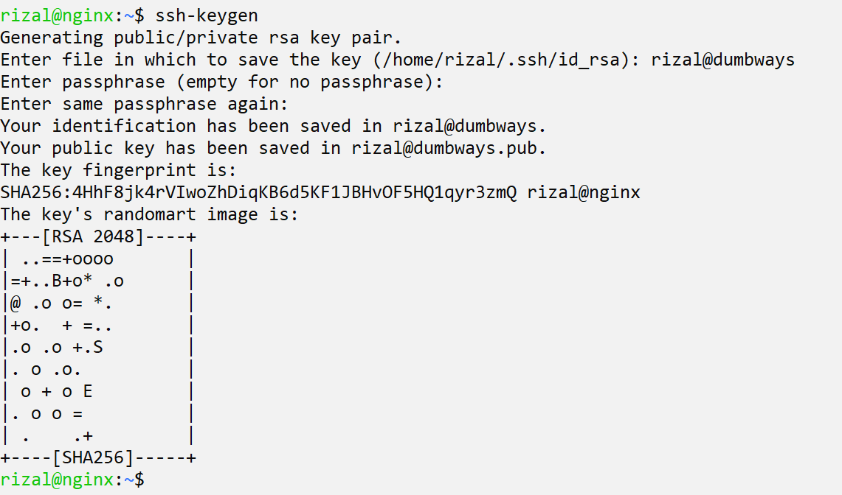
SSH
31

Slide 32
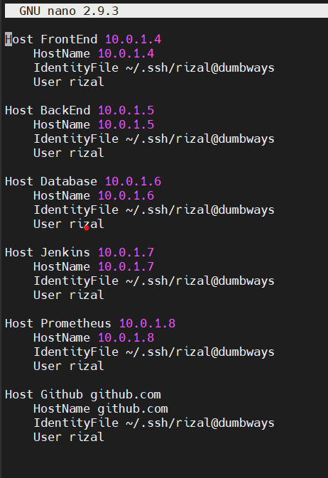
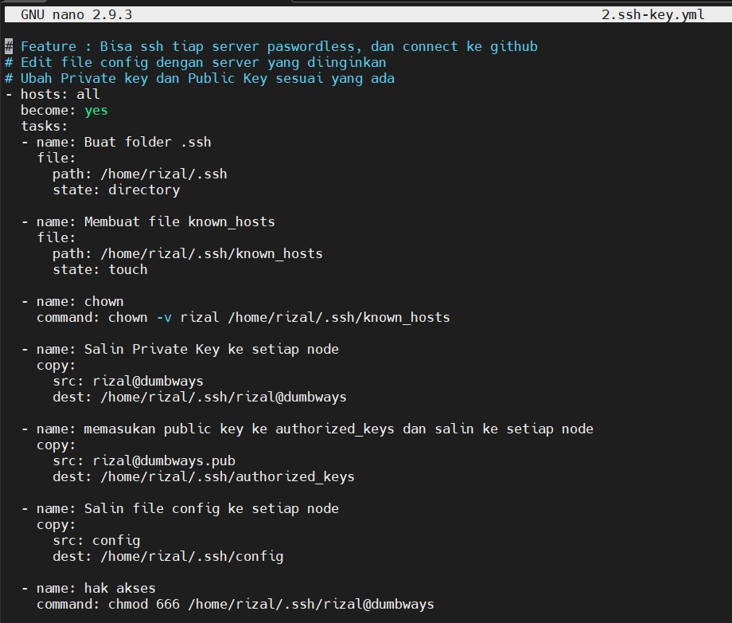
SSH
32

Slide 33
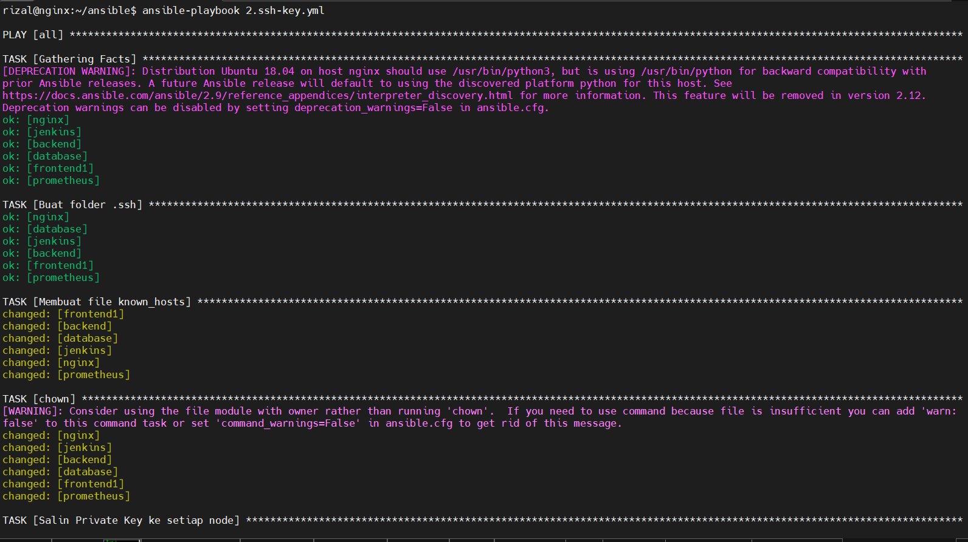
SSH
33

Slide 34
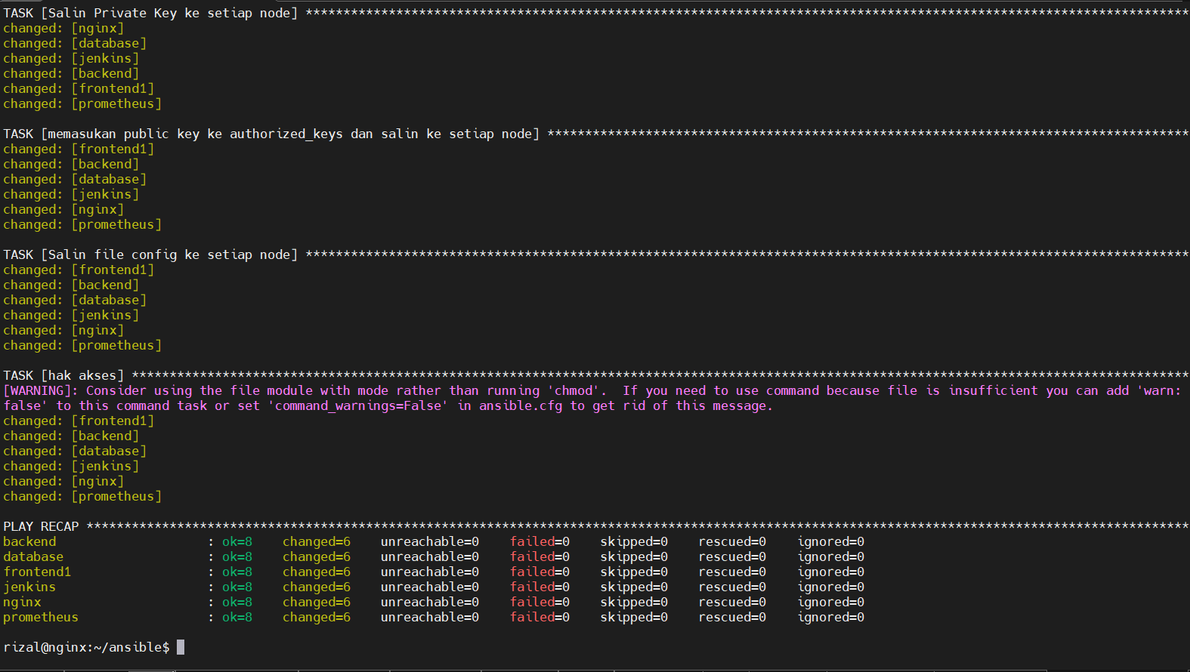
SSH
34

Slide 35
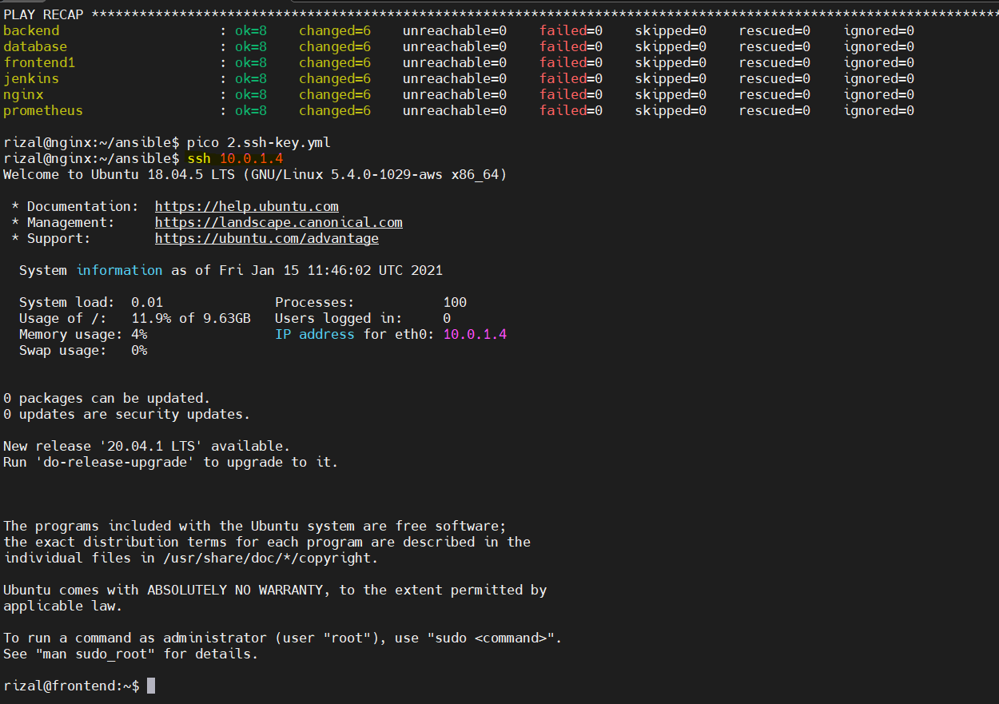
SSH
35

Slide 36
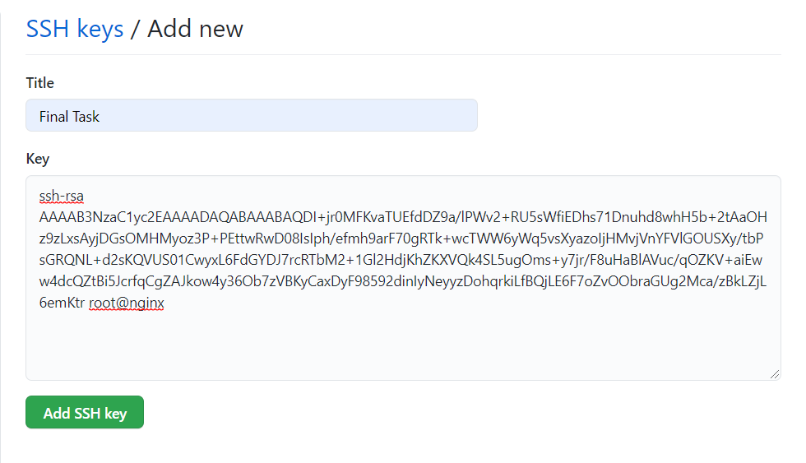
SSH
36

Slide 37
SSH
37

Slide 38
Database
5
Database Cluster satu instance

Slide 39
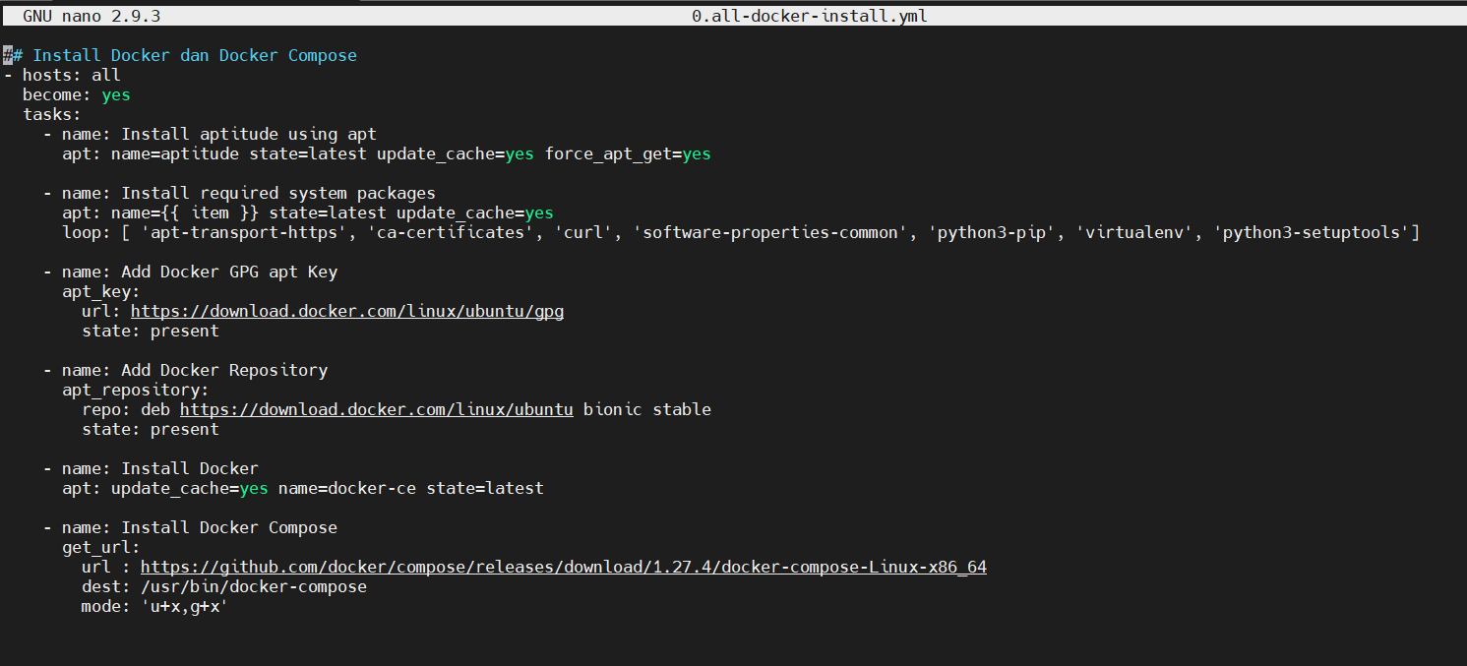
Database
39

Slide 40
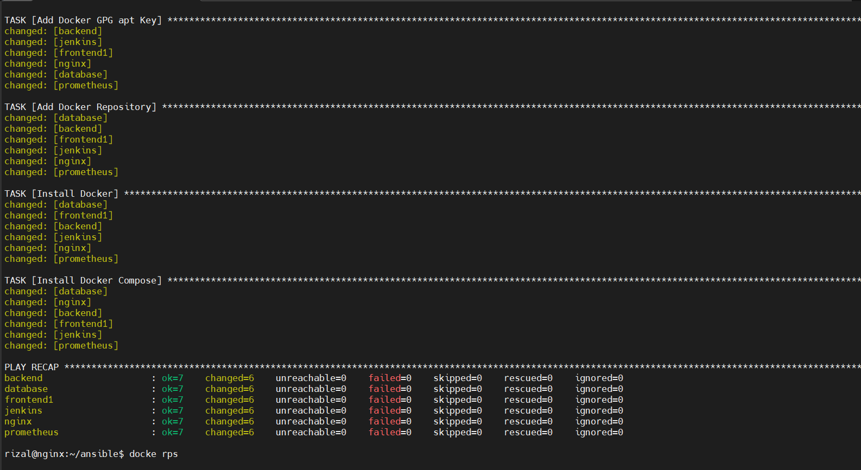
Database
40

Slide 41
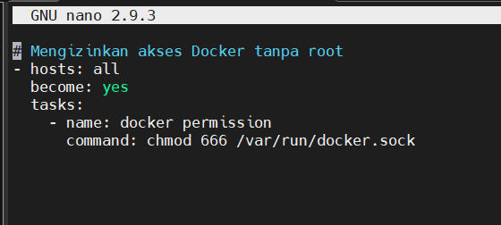
Database
41

Slide 42
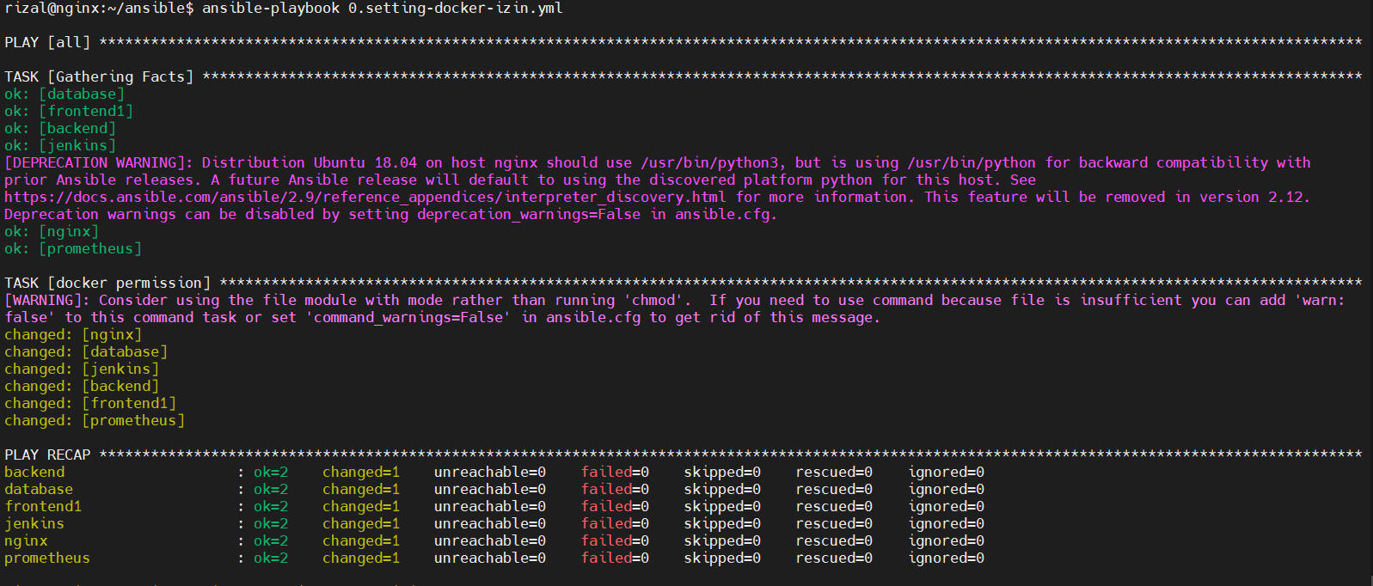
Database
42

Slide 43
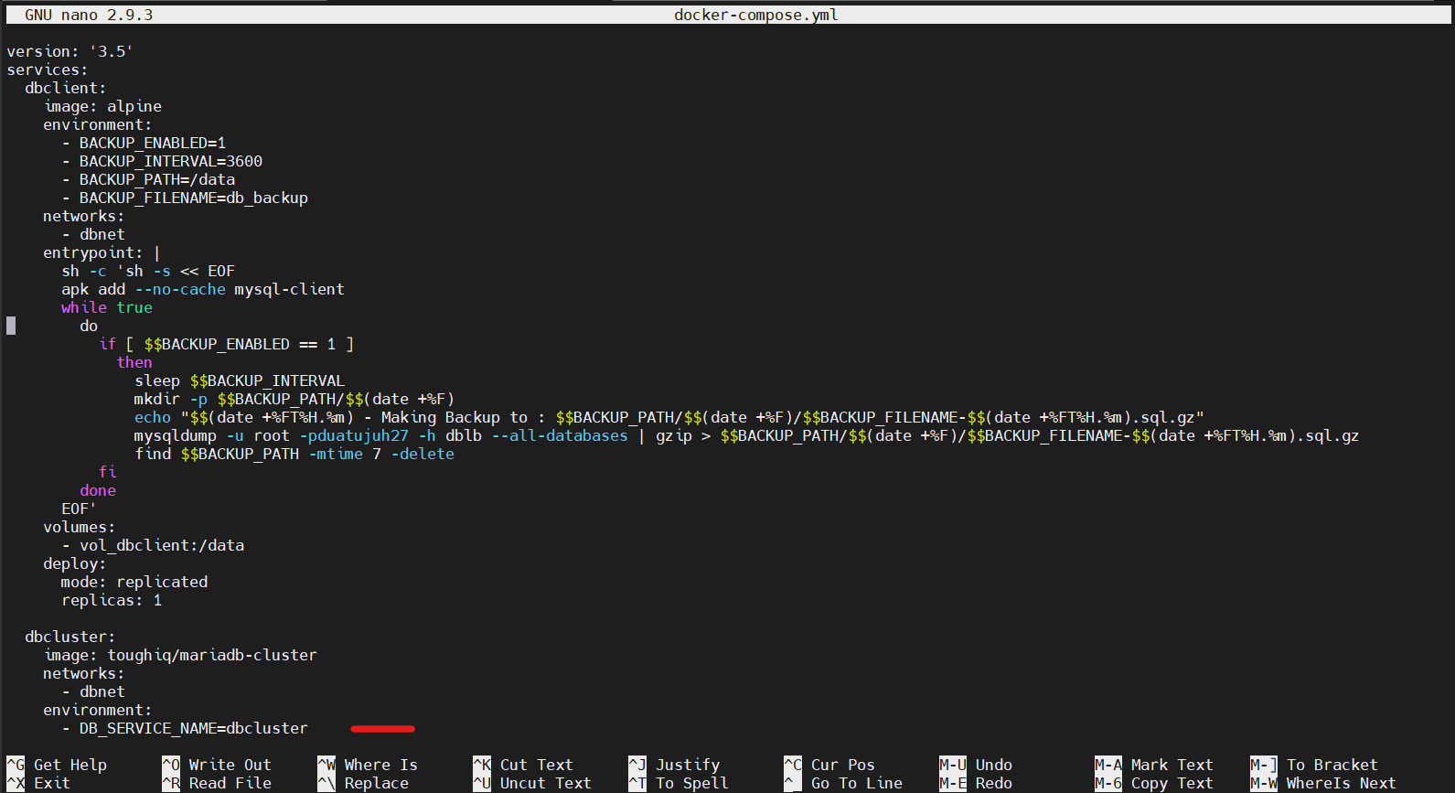
Database
43

Slide 44
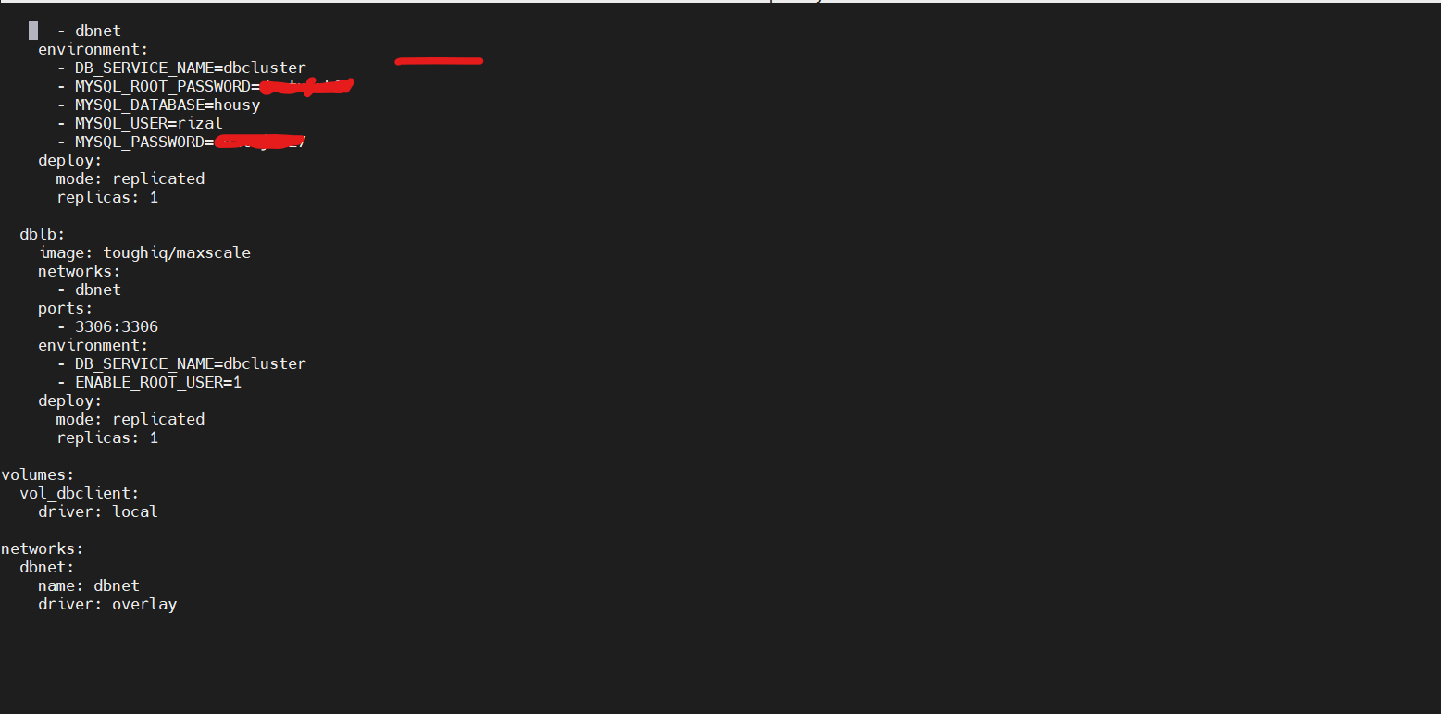
Database
44

Slide 45
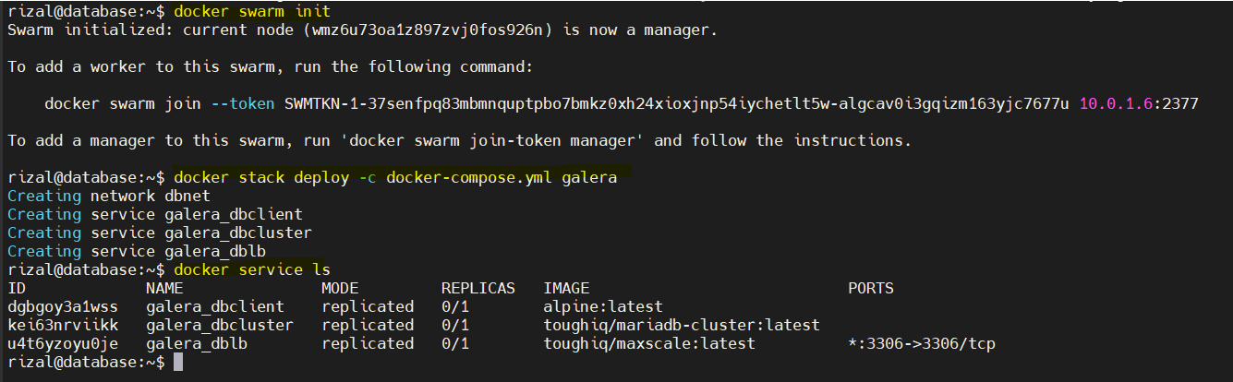
Database
45

Slide 46
Database
46

Slide 47
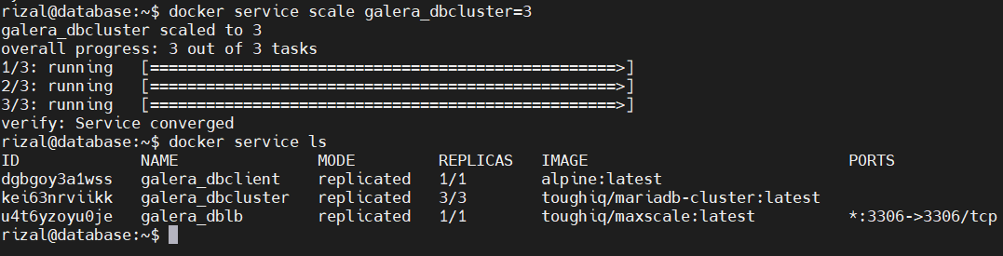
Database
47

Slide 48
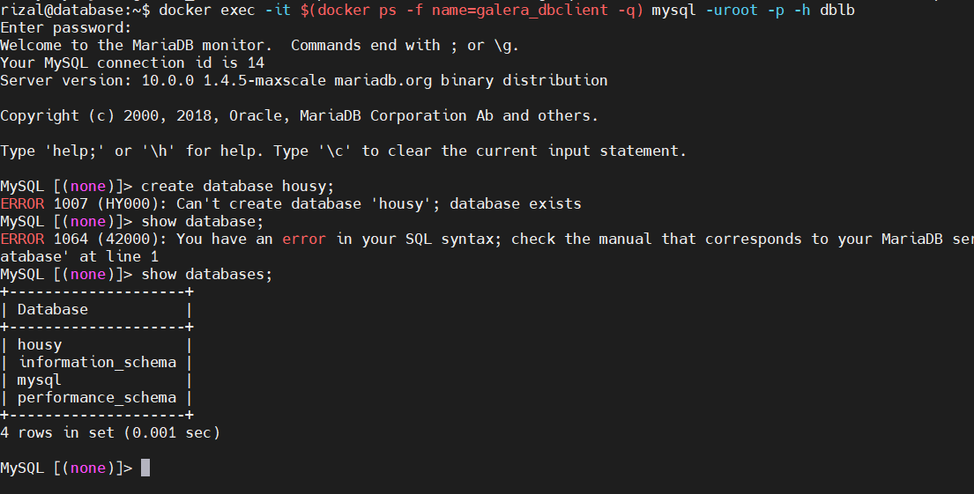
Database
48

Slide 49
Web Server
6
Set Load balance dan Reverse Proxy

Slide 50
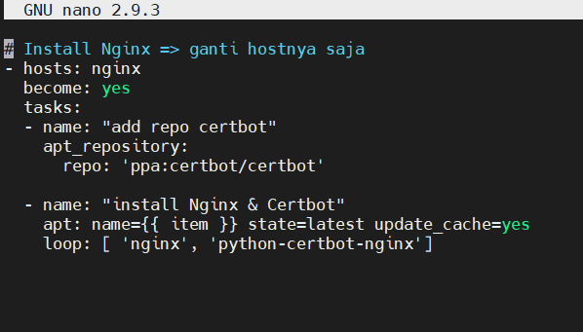
Web Server
50

Slide 51
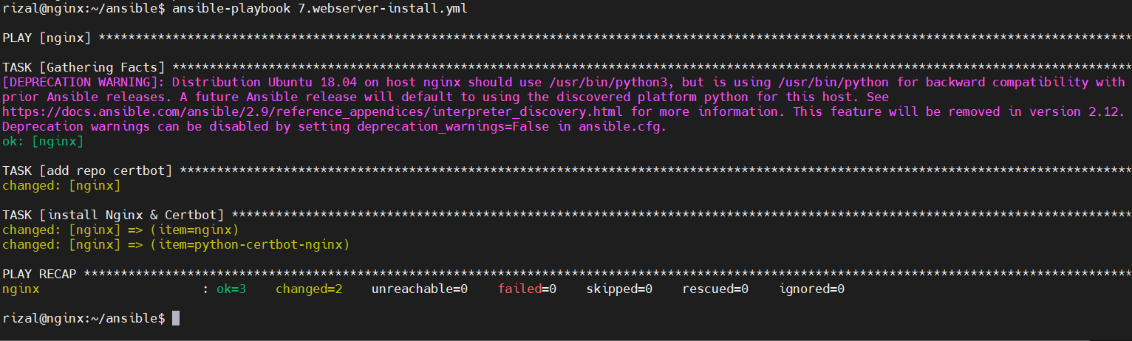
Web Server
51

Slide 52
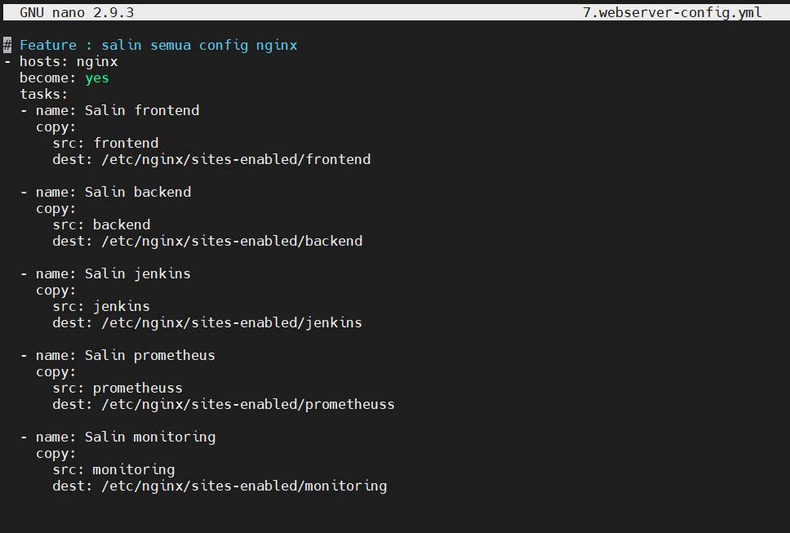
Web Server
52

Slide 53
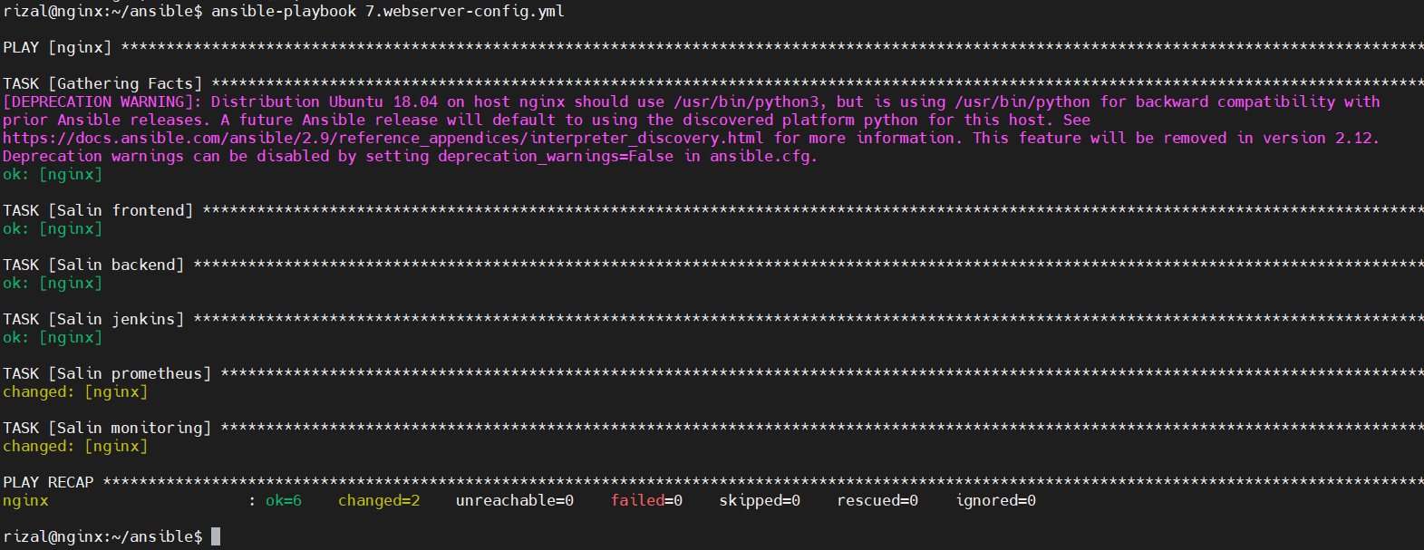
Web Server
53

Slide 54
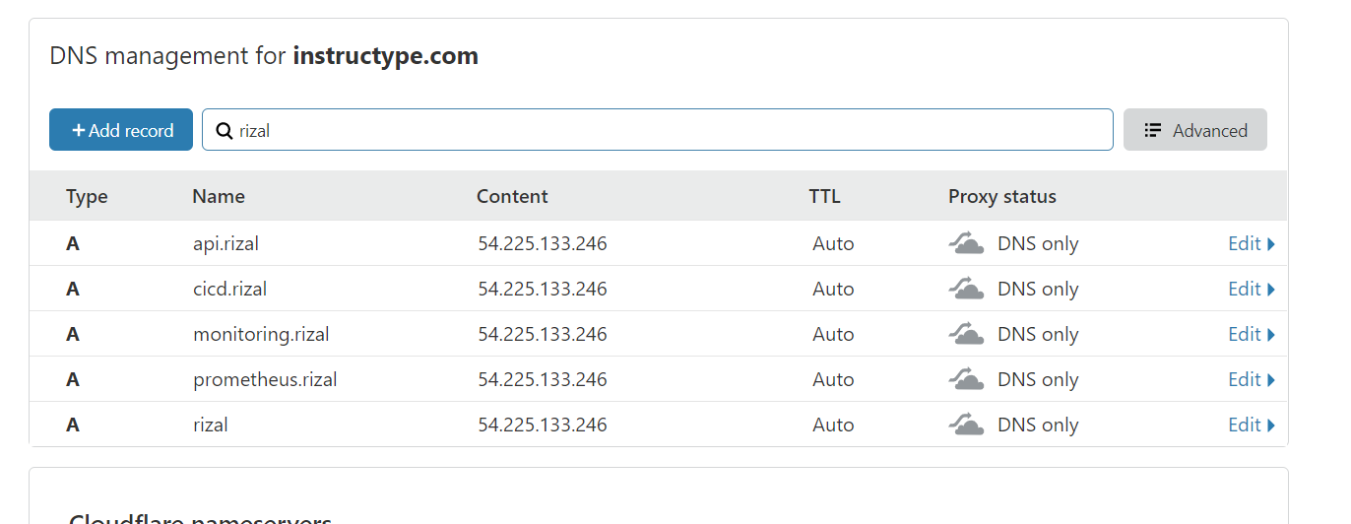
Web Server
54

Slide 55
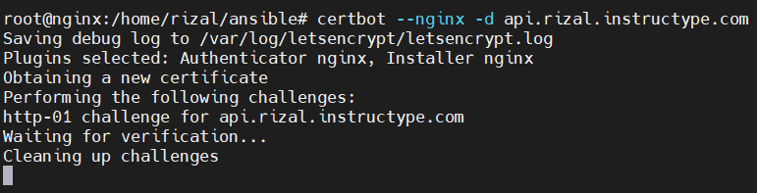
Web Server
55

Slide 56
Deployment
7
Deploy FrontEnd dan BackEnd

Slide 57
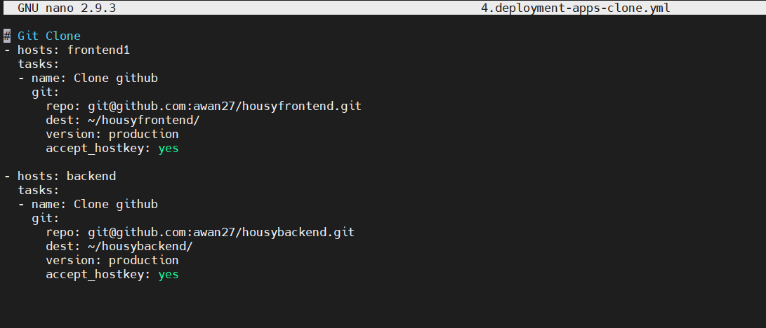
Deployment
57

Slide 58
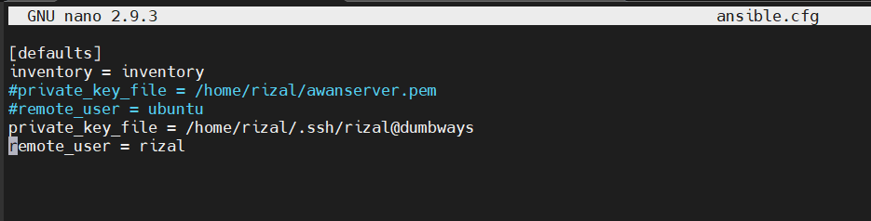
Deployment
58

Slide 59
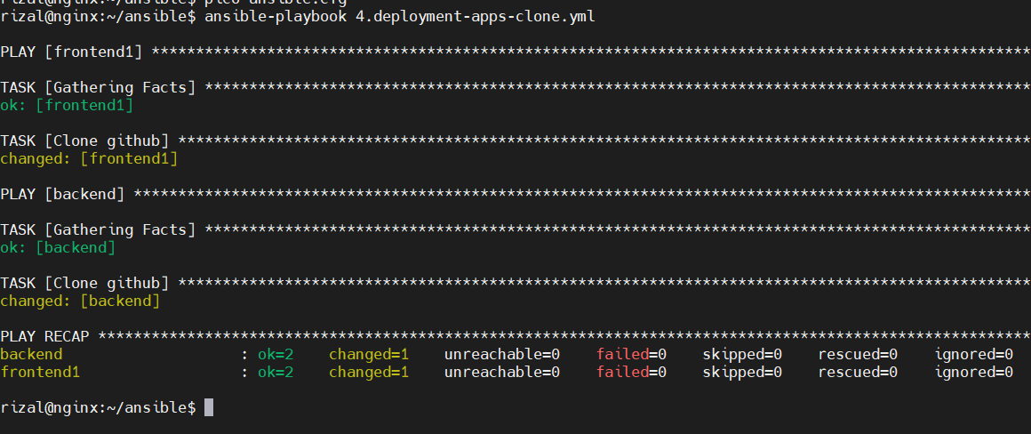
Deployment
59

Slide 60
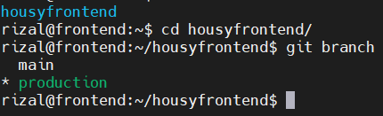

Deployment
60

Slide 61


Deployment
61

Slide 62


Deployment
62

Slide 63

Deployment
63

Slide 64


Deployment
64

Slide 65

Deployment
65

Slide 66

Deployment
66

Slide 67

Deployment
67

Slide 68

Deployment
68

Slide 69

Deployment
69

Slide 70
CICD
8
Automated Build

Slide 71

CICD
71

Slide 72

CICD
72

Slide 73
CICD
73

Slide 74

CICD
74

Slide 75

CICD
75

Slide 76

CICD
76

Slide 77

CICD
77

Slide 78


CICD
78

Slide 79

CICD
79

Slide 80

CICD
80

Slide 81

CICD
81

Slide 82

CICD
82

Slide 83

CICD
83

Slide 84

CICD
84

Slide 85

CICD
85

Slide 86

CICD
86

Slide 87

CICD
87

Slide 88

CICD
88

Slide 89

CICD
89

Slide 90
Monitoring
9
Setup node exporter, Prometheus, dan grafana

Slide 91

Monitoring
91

Slide 92

Monitoring
92

Slide 93

Monitoring
93

Slide 94

Monitoring
94

Slide 95

Monitoring
95

Slide 96

Monitoring
96

Slide 97

Monitoring
97

Slide 98

Monitoring
98

Slide 99

Monitoring
99

Slide 100
Auth
10
Setup login prometheus

Slide 101

Auth
101

Slide 102

Auth
102

Slide 103

Auth
103

Slide 104
Auth
104

Slide 105

Auth
105

Slide 106
Thanks!
Ada pertanyaan?

